Slide 1
Coalition Formation Using Lanchester Model: Including Internal and External Stability between two coalitions
Author & Illustrator – Rupeshkumar Kanpariya
Researcher – Dharmik Dave
Co-Author & Programmer – Paras Bhalala
Date :- 24.07.2024
Course:- M.Sc MMSO
Under the guidance of: Dr. Radomir Pestow
Name :- Mahek Pankhaniya
Course:- M.sc MMSO
Matriculation Number:-
Date :- 09.02.2024

Slide 2
Content
Introduction
About Lanchester Model
Balance of Power Theory
Models and Methods
Coalition Building or Formation
Internal and External Stability conditions of coalitions
Geographical Demonstration
Mathematical Background
Result and Stability Analysis
Discussion
Conclusion

Slide 3
01. Introduction
1.1 : Introduction of Lanchester Model
Frederick William Lanchester, as a mathematician, described the first combat dynamics model in 1916 during World War I, has developed two primary models to describe different types of combat:
Lanchester’s Linear Law:
It used for only close combat situations of ancient and medieval warfare, for example, infantry, cavalry, archers and more.
Lanchester’s Square Law:
Generally, used for modern combat strategies, where the effectiveness of an army is proportional to the square of its army size or army base. This reflects the increased range of modern weapons, such as firearms, aircraft.
Notes:
Dipeptide -2 , Tripeptide-3,
Protein- one or more polypetide

Slide 4
01. Introduction
1.2 : Balance of Power Theory
Defination:
To deals with relations of countries in the world.
To explains how countries try to prevent any one country from becoming too powerful.
They form alliances and build up their own military strength to ensure that no single country can dominate or threaten others.
Objectives or Aims:
To maintain a stable relationship between strong and weak countries while preventing any one country from becoming too dominating.
Examples:
Cold war (20th century): Bipolar Balance- US and Soviet Union.

Slide 5
02. Objective
To analyze the stability condition of coalitions, when the coalitions are internally and externally stable.
To highlight the role of balance of power in coalition interactions and understanding how the achievement of strategic territories and resources can disrupt the balance of power.
To analyze how the fraction of kill rate relates to number of countries in each coalition.

Slide 6
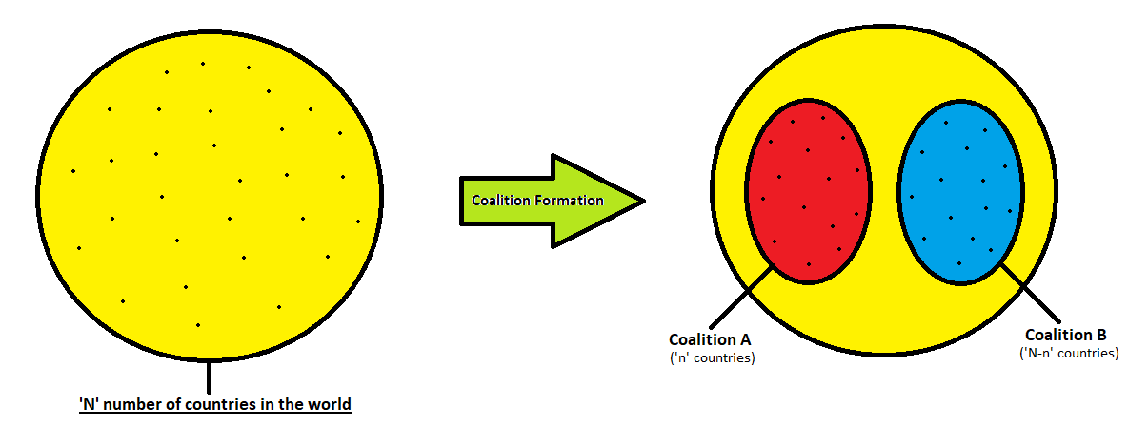
03. Model and Methods
Coalition Building or Formation:
Defination of Coalition:
Two or more countries that work together to reach a common goal.
Why and when the country wants to form or join coalition? – doesn’t have enough people power or resources to make a impact on war.

Slide 7
3.1: Coalition Formation
Total N number of countries in the world, n number of countries join coalition A and remaining (N-n) countries join coalition B.
The total number of army is $$A_{i}$$ for each country i.
Initially,
Army Force of coalition A ($$F_{A}$$) = $$n∗A_{i}$$
Army Force of coalititon B ($$F_{B}$$) = $$\left(N−n\right)∗A_{i}$$

Slide 8
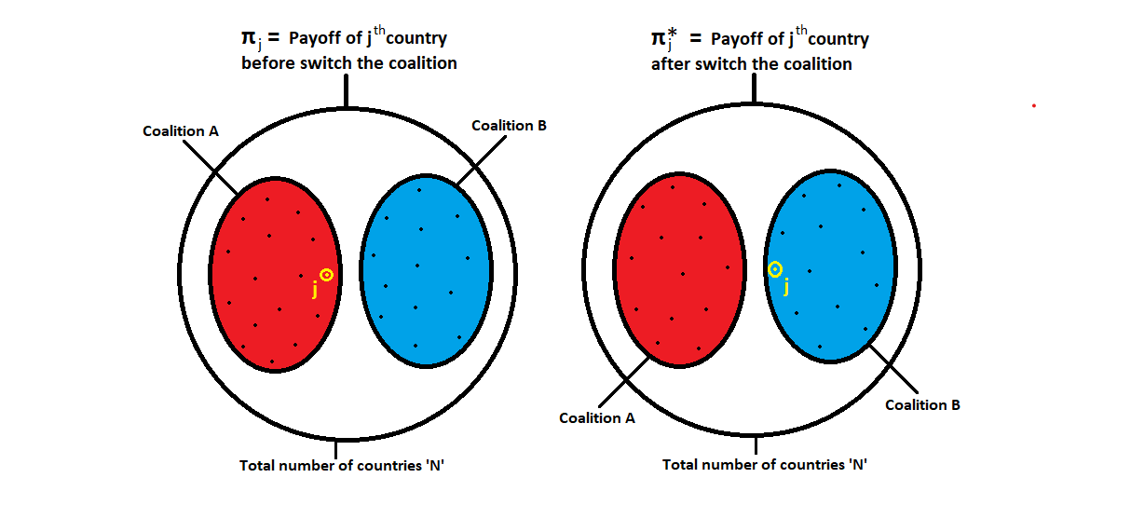
3.2: Internal and External Stability conditions of coalitions
$$π(j, \left\{a_{1},a_{2},…j,...a_{n}\right\},\{b_{1},b_{2},….b_{m}\})$$
Where $$j$$ is the country of coalition A and $$a_{1},a_{2},….a_{n}$$ all countries of coalition A and $$b_{1},b_{2},….b_{m}$$ are all countries of coalition B.

Slide 9
3.2: Internal and External Stability conditions of coalitions
Coalition A is internally stable if and only if Coalition B is externally stable.
For every $$a_{j}∈A$$,
$$π(a_{j}, \left\{a_{1},a_{2},…a_{j},...a_{n}\right\},\{b_{1},b_{2},….b_{m}\})$$
$$≥ π* (a_{j}, \left\{a_{1},a_{2},….a_{n−1}\right\},\{{a_{j},b}_{1},b_{2},….b_{m}\})$$
Coalition A is externally stable if and only if coalition B is internally stable.
For every $$b_{j}∈B$$,
$$π(b_{j}, \left\{a_{1},a_{2},...a_{n}\right\},\{b_{1},b_{2},…b_{j},...b_{m}\})$$
$$≥ π* (b_{j}, \left\{{b_{j}, a}_{1},a_{2},…a_{n}\right\},\{b_{1},b_{2},….b_{m−1}\})$$

Slide 10
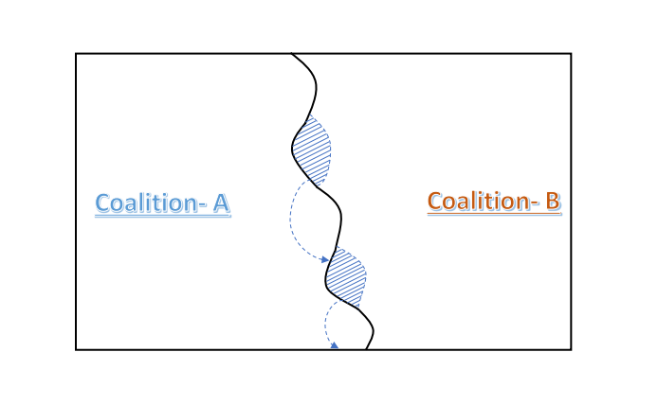
3.3: Geographical Demonstration
Coalition A and Coalition B start with equal power and territory.
The balance can be disrupted if one coalition gains an advantage.
Capturing valuable regions from the opposing coalition can shift the balance.
As Coalition A's power grows, it becomes harder for Coalition B to defend its territory.
This cycle can eventually lead Coalition A to dominate the entire region.

Slide 11
3.4: Mathematical Background
Lanchester equations:
$$\frac{dA}{dt}=−k_{b}∗B$$ ........ (1) (For Coalition A)
$$\frac{dB}{dt}=−k_{a}∗A$$........(2) (For Coalition B)
Now, cross multiplication,
$$k_{a}∗A∗\frac{dA}{dt}=k_{b}∗B∗\frac{dB}{dt}$$
Integrating above equation,
$$k_{b}∗\frac{B^{2}}{2}−k_{a}∗\frac{A^{2}}{2}=E$$ .....(3)
If E > 0 then coalition B should win.
If E < 0 then coalition A should win.
If E = 0 then It is a stable situation.

Slide 12
3.4: Mathematical Background
For stable situation, E = 0.
From equation (3),
$$k_{b}∗\frac{B^{2}}{2}−k_{a}∗\frac{A^{2}}{2}=0$$
By solving and putting initial value,
𝑛=𝑁𝑘𝑎𝑘𝑏+1

Slide 13
04. Results and Stability Analysis
Always seek for more power to get an advantages.
Hence, Militaristic stable is always politically unstable.

Slide 14
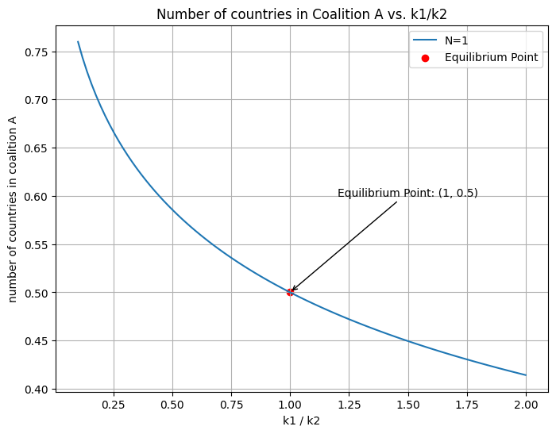
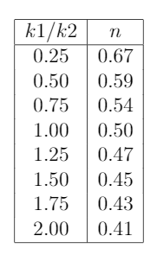
04. Results and Stability Analysis
How the fraction of kill rate relates to number of countries in each coalition.

Slide 15
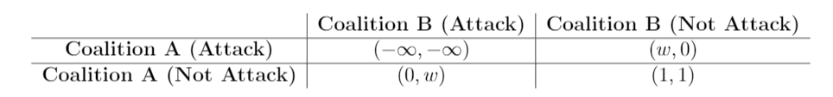
05. Discussion
Mutually Assured Destruction (MAD):
If both coalitions engage in a nuclear war, both suffer total destruction
If one coalition attacks while the other does not, the attacking coalition suffers significant but not total destruction (represented as w, where w<1).
If both coalitions avoid attacking each other, they enjoy a stable and peaceful situation.

Slide 16
06. Conclusion
We conclude that a coalition's internal stability is achieved when no members can benefit from leaving the coalition, while external stability is maintained when the coalition is resistant to the addition of new members from opposing forces.
Furthermore, the research incorporates geopolitical considerations, emphasizing the significant chance of geographical advantages in coalition dynamics. The acquisition of strategic territories and resources by one coalition can disrupt the balance of power, leading to potential dominance over the opposing coalition.
The study discusses the implications of Mutually Assured Destruction (MAD) and the potential for transitioning to Mutually Assured Stability (MAS).

Slide 17
Thank you all for your Attention!

